Slide 1
Lightning Talk: Technical Challenges
SD Dec21-02

Slide 2
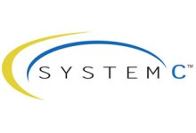
Connecting SystemC Model to the Outside World
How to connect our simulated environment to the host operating system
Need to communicate bi-directionally
Needs to be robust for continued streams of data
Needs to sync with simulations
Needs to support multiple emulated devices
Researching protocols and libraries to use
Finding documentation and examples of use
Implementing the protocols and libraries in our design

Slide 3
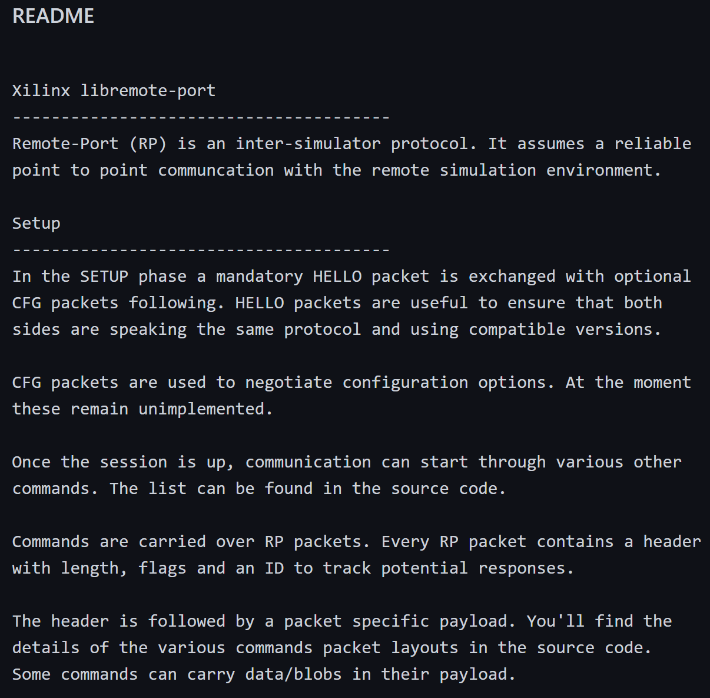
Initial Ideas
Initially reaching out to the development community (Github)
Recommended libremote-port library to make connection
Mentioned pre-built protocols for data packets
Little documentation so digging into implementation of the library and examples of implementation in thread demo and basic initial co-sim demo
Client had mentioned UDP packets as a simple protocol
Interface with SystemC server state machine with scripting language (Python)
Custom headers to match specific needs

Slide 4
Challenges
Libremote-port documentation is limited
Demos are complicated to compile and run
Blocking issues during compilation
Running demos has little documentation
Very few documentation outside of minimal examples
SystemC interaction is still new to the team
Still bringing team members up to speed on technologies
Few debugging hooks for implementation

Slide 5
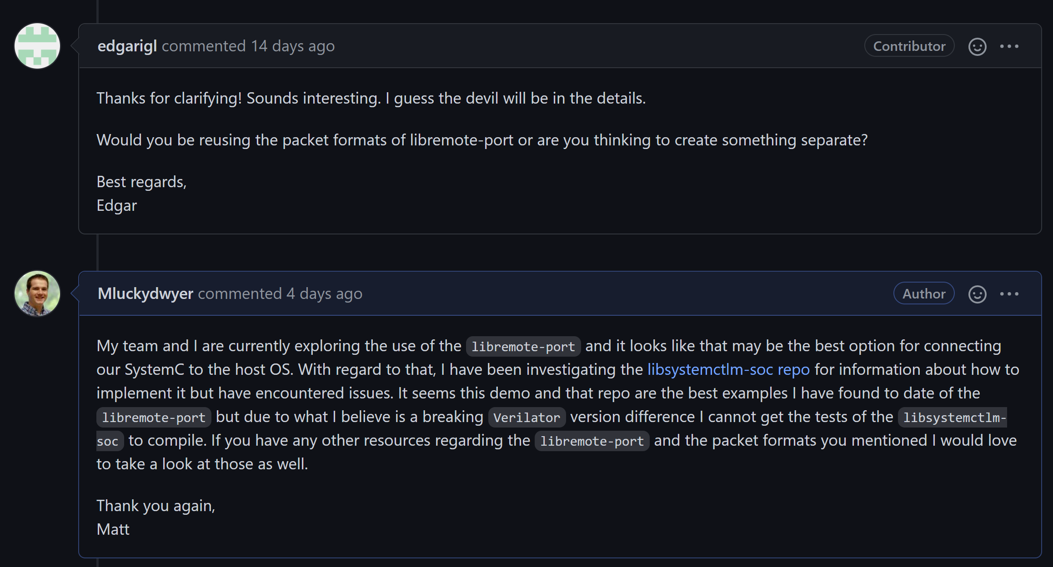
Overcoming Them
Continuing dialog with development community
Continuing to seek out additional documentation and resources
Exploring suggestions for implementation by community devs
Working with client to connect with SystemC veteran devs
Building prototypes and failing fast to make progress
Progressive demos (each a bit more than the last)
Diagramming understanding and plan to see flaws before we implement them

Slide 6
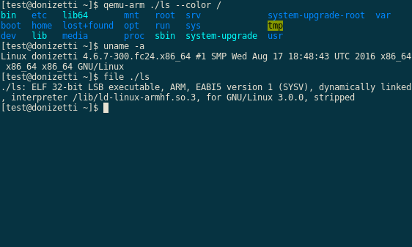
Other Challenges
Documentation in general for the tools is sparse
Working with SystemC and QEMU is new for all team members
FPGAs in general can be complicated
Building custom Linux drivers will be a new experience for all team members
Continuing to communicate effectively in the team
Distributing work among team members
Maintaining constant interaction with development community

