Slide 1
Lightning Talk #1
Matthew Dwyer
Prince Tshombe
Braedon Giblin
Cody Tomkins
Spencer Davis
Group Sddec-02
Co-Simulation of a Avionics Interface Device

Slide 2
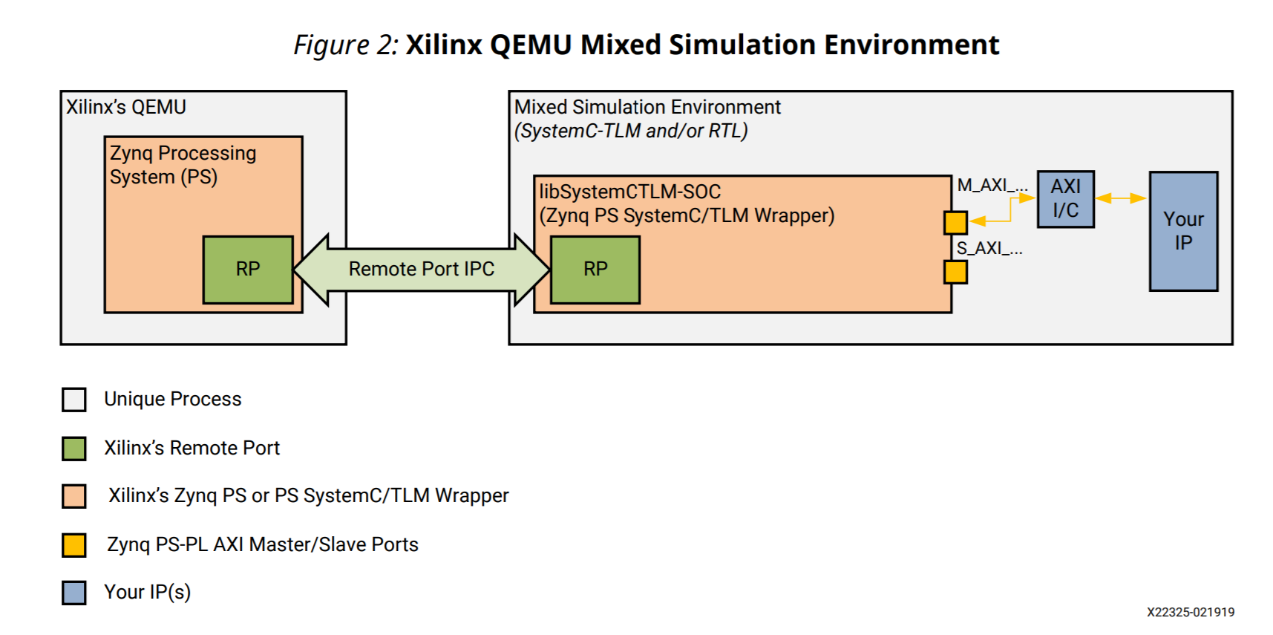
Project Overview
How can you write hardware and software in independently?
Emulating hardware mechanics utilizing SystemC implementations:
Encode basic interactions of HW to memory-mapped comms.
This abstracts SW’s knowledge of HW, only interactions
Simulating system firmware on processor
QEMU used to simulate Xilinx platform
Communicates with HW through memory-mapped data with SystemC-TLM
Can allow for easier testing and development of custom hardware and Linux firmware for deviecs
Notes:
Matt

Slide 3
Functional Requirements
SystemC / QEMU co-simulation benchmarks should be built and operational
Prove our understanding of the various modeling tools and methodology
Import additional hardware into the model (e.g. a temperature sensor)
Notes:
Spencer
After meeting with our sponsor, we were able to narrow down the project scope into the following functional requirements.
First, system C, QEMU
Second, develop tech that proves our understanding
Third, import additional hardware. Greatly increases functionality and reusability of our system.

Slide 4
Non-Functional Requirements
Clear instructions on replicating our work
Publishing our work to public open-source projects
Following the coding standards and documentation standards prescribed per each public problem
Notes:
Prince
Publishing to public repositories
Following the public code and documentation standards for those repos
Getting a full demo of end-to-end Linux driver for the protocols he mentions in the abstract

Slide 5
Software Standards
Abide by the coding standard that is evident in the repository we are using
Make code readable for anyone that will use it (talk through your logic through comments for each process)
If we have any questions, ask the repository moderators what they think would be best.
Notes:
Cody

Slide 6
Documentation Standards
Documentation should match whichever project is actively being contributed too
In general, documentation should be concise though descriptive
Documentation should be public for public projects, and proprietary when working with proprietary system
Notes:
Braedon

